Slide 1
S.M.A.R.T HUB for Domestic Appliance switching.
(S:Seamless,M:Moneywise efficient,A:Aesthetically appealing,R:RetroFit,T:Technologically advanced
Jugal Jeetendra Manek
BE-EXTC
SVKM’S DWARKADAS J SANGHVI COLLEGE OF ENGINEERING,
VILLE PARLE, MUMBAI

Slide 2
Abstract
With the advancement in virtual assistants like Google Assistant and Alexa, Home automation and Voice controlled applications are becoming normal.
But this project here is different, the idea here is to create a practical Home automation board that can fit into our AC power units on our walls and stay concealed inside it. The board should not interrupt the normal working of our power unit switches, that is they should turn ON or OFF with manual switches as well. And without being said, it should also be able to control the same load with voice.
So Finally the project Incorporates the Features such as Voice Control (Over Bluetooth),Mobile control (Over Bluetooth),Control Over the internet through the Blynk app(From anywhere in the world),Also these are touch sensor based switches so that ANY NON METALLIC MATERIAL can be used to make the switch surface.
Also the project comes the promise of No Single Extra Wire Required that is absolutely Plug And Play approach. Also the project comes with a ton lot of possibilities for Future upgradations and customizations.
Since we have integrated Blynk and voice control, the project gets interesting and practical to use.

Slide 3
AIM & OBJECTIVE
Thus the Aim here is to create a Home automation system that is true to its USPs that are:
S:Seamless
M:Moneywise efficient
A:Aesthetically appealing
R:RetroFit
T: Technologically advanced
Along with these the system also comes with a plethora of Future Upgradation opportunities that are discussed ahead, which can easily integrate upcoming technologies to keep up with the changing demands of the customers.

Slide 4
Other U SPs
Affordability
Versatility
Retrofit
State of the art

Slide 5
Literature Survey
Home Automation is a product or service that brings some level of action or message to the home environment, an event that was generated without the homeowner’s direct intervention. The words “home” and “automation” fit together perfectly to describe how to get things done easier, better, and faster than ever before, which equates to convenience.^{[1]}
Home automation technology has changed a great deal over the decades. The way that home automation worked in whole-home solutions of the past was that a central controller was placed in the home and the user controlled it through wall-mounted keypads and remote control boxes.^{[2]}
These days, whole-home solutions are much improved and incorporate Internet and network-based technologies to connect you to your home. We can also remotely control our home using smartphones and tablets. The operating systems are typically customized for their clients, though, as is everything in a whole-home system. Modular Internet and network-based solutions that utilize apps and the web are taking the market by storm, due to affordability, convenience, and the capability to be added on to.^{[2]}

Slide 6
Literature Survey
Another factor in their growth is that folks are familiar with their modes of usage. Lots and lots of people have smartphones and tablets today, and most of those devices are running on iOS or Android operating systems. The modular home automation solutions allow us to buy products that you interact with through other products (our smart devices and home network) that we are already familiar with^{.[2]}
Future for the Home Automation systems involves making homes even smarter. Homes can be interfaced with sensors including motion sensors, light sensors and temperature sensors and provide automated toggling of devices based on conditions. More energy can be conserved by ensuring occupation of the house before turning on devices and checking brightness and turning off lights if not necessary. The system can be integrated closely with home security solutions to allow greater control and safety for home owners.^{[3]}

Slide 7
Methodology
Here an esp32 board serves as the central controller which comes with an inbuilt Wi-Fi & Bluetooth module. This controller is used to control the relays that provide the actual switching for which an 8 channel relay module has been used. The circuit diagram is such that it can also operate simultaneously with push button or normal mechanical switches that that might be available at the customer end.
However here in place of push button switches we have used capacitive touch sensor so as to provide touch-based Switches.
The system can be operated over Bluetooth or over the internet. To use it over Bluetooth we make use of a Bluetooth Android app that sends a particular Character when an action is taken in the App.

Slide 8
Methodology
The Bluetooth App provides various layouts such as Toggle Switch Layout, or Voice Control Layout etc. So we can operate the switch using the screen of the smart phone or through Voice commands .
The system can also be operated over the internet through the Blynk App. This makes it possible to operate the Switches from ANY WHERE IN THE WORLD.
Here by the Virtue of the Bluetooth App we can also have Scene Configuration, that is configure the status of multiple loads into a single Command.

Slide 9
Methodology
Fan Dimmer Circuit:
In the circuit we have two RC circuits. The values of resistors and capacitors in the circuit are as follows: ● R1 = 220kΩ , ¼ W ● R3 = 220kΩ , ¼ W ● R2 = 2.2Ω , ½ W ● R4 = 2.2Ω , ½ W ● C1 = 2.2 uF, 250V ● C2 = 3.3 uF, 250V These RC circuits will limit the current flowing through it. The common terminal is connected to knob 1, the current flows through R1, R2 and C1. Here the reactance is more, so less current flows through it which will result in fan rotating with less intensity or slow speed. The common terminal is connected to knob 2, the current flows through R3, R4 and C2. Here the reactance is less, so more current flows through it which will result in fan rotating with more intensity or higher speed. When common terminal is connected to knob 3, it is short and the current flowing through it will be maximum, which will result in fan rotating in its highest speed.

Slide 10
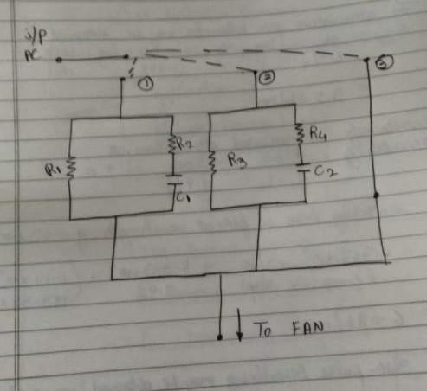
Methodology
Fan Dimmer Circuit:

Slide 11
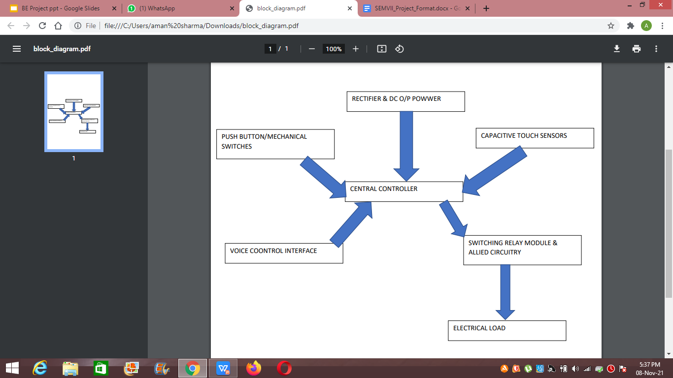
Methodology

Slide 12
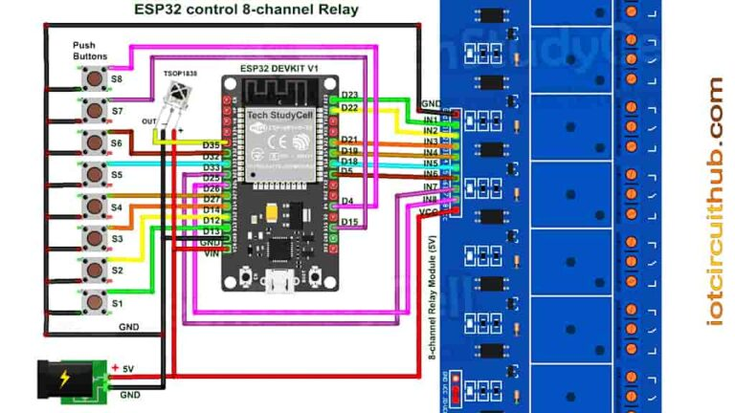
Methodology

Slide 13
Application of Project
The advancement in technology and invention of innovative products has significantly contributed in making our lives easier. One such innovation was home automation. Generally, a home automation system is installed before the construction of our houses. The motivation behind our project is to develop a cost effective home automation system which can automate the existing appliances in already built houses using different control mechanisms i.e. through an App, touch or Voice ( using Google Assistant).
Our Home automation board will fit into our AC power units into walls. It will stay concealed inside it and will not interrupt the normal working of power unit switches. We would be able to .turn ON and OFF with manual switches as well as with our Home Automation

Slide 14
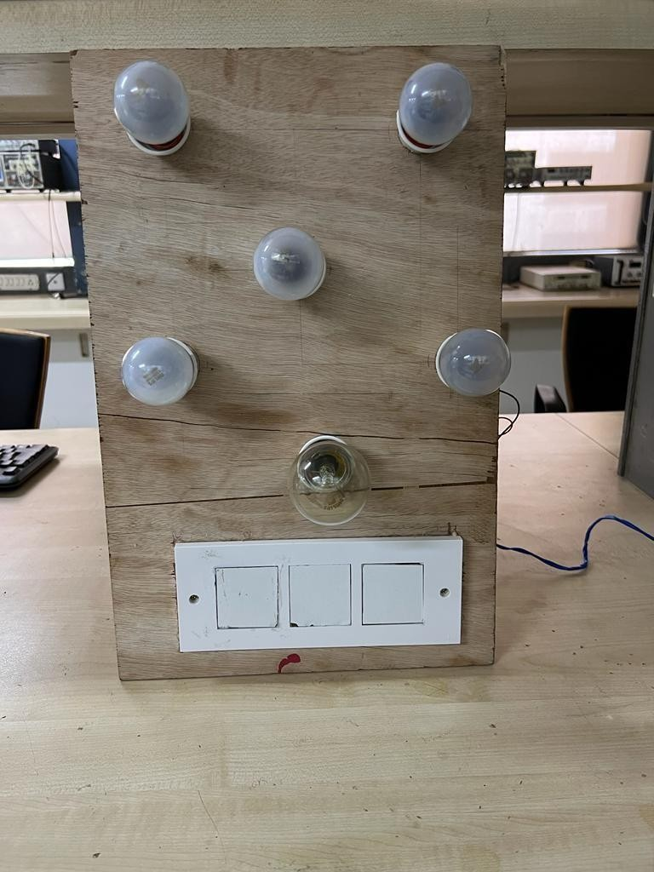
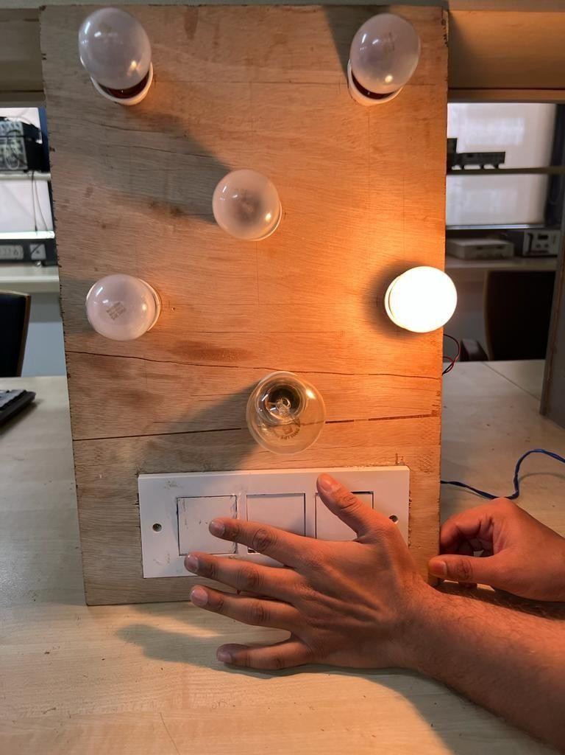
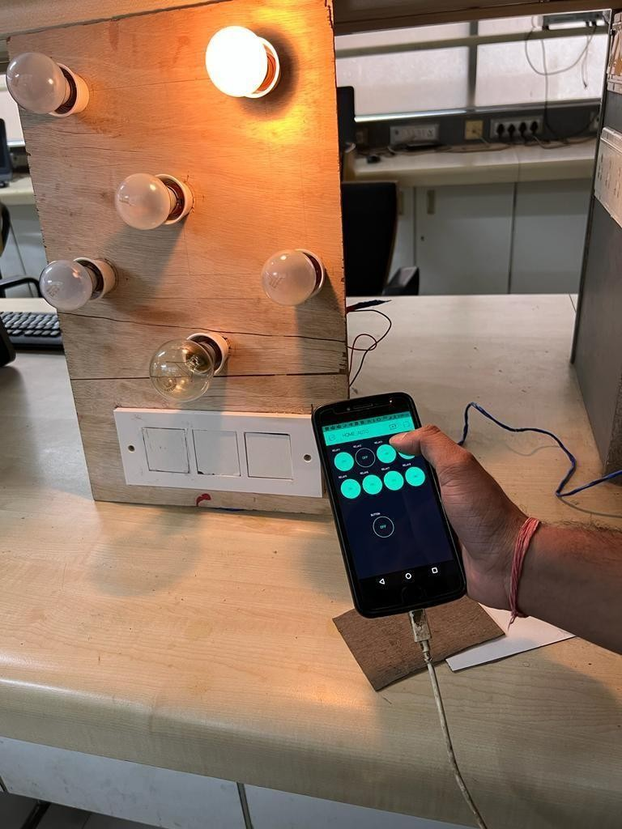
Results
Switching of load using Blynk app over the internet

Slide 15
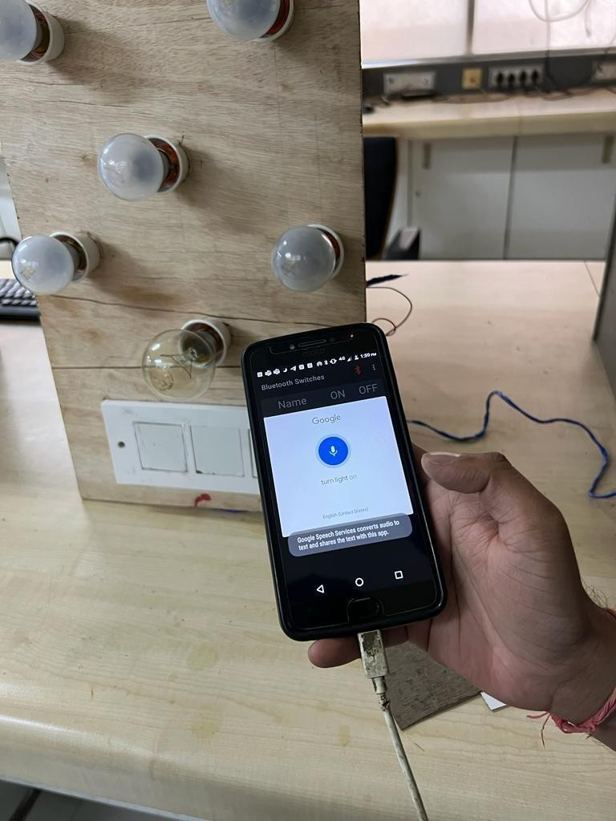
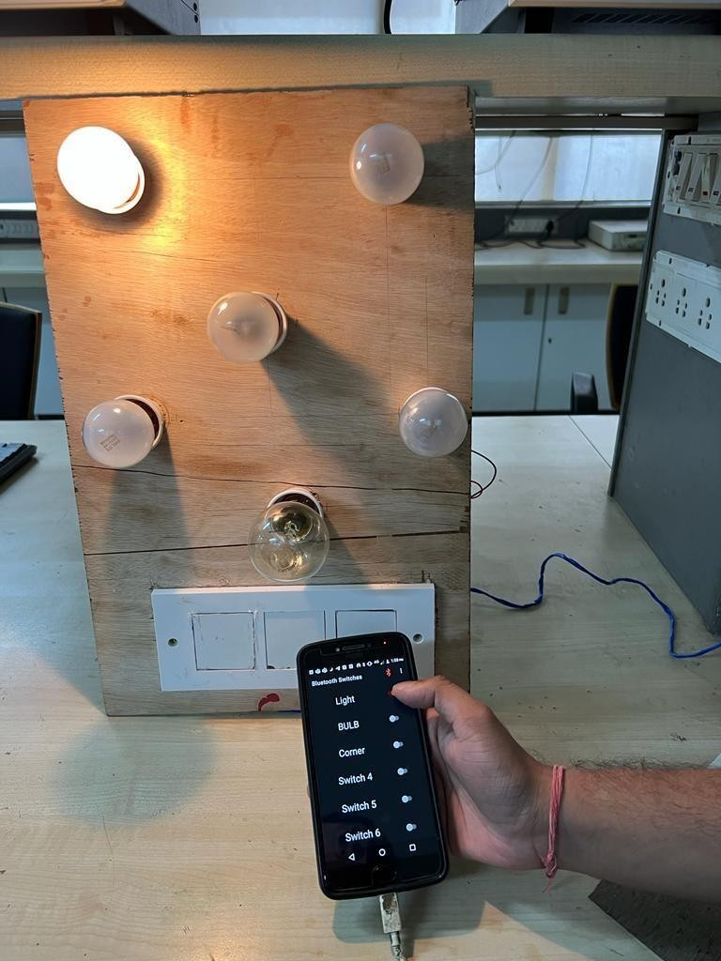
Results
Switching of load by Voice command & Toggle switch layout in Bluetooth app

Slide 16
Future Scope
With the continuous advances in home automation technology this field is poised to grow with leaps and bounds and as we bring in more and more Connected devices together the scope and reach of home automation systems will continue to grow.
As far as our project is concerned we can propose a few clearly foreseeable upgrades for the same, Namely:
Interfacing with available voice assistants like Amazon Alexa, Google Home kit, Apple’s Hey Siri etc.
More sensors can be incorporated so as to increase the reach of the system such as temperature sensor, Day/night Sensor, Motion(person) Sensor,Heat Sensor etc.
Scene configuration, ie Configuring status of various switches into a single switch blended with conditions on time,season or mood.
Switch Application through QR CODE or AUGMENTED REALITY
Use of Long Distance communication alternatives over the one incorporated such as LORAWan etc.
Surface materials for the switches can be changed to bring out more aesthetically appealing switch.

Slide 17
CONCLUSION
We have been successful in building our SMART HUB for domestic appliance switching.
We have achieved the objectives of our project.
With this system we are able to turn a non-metallic surface (Sunmica) into a touch based switch board using capacitive touch sensors providing touch based switching. We are also able to control appliances using a Bluetooth app, configuring it with ESP32 microcontroller and switching using Voice commands and virtual switches without internet.
With internet, we are able to control switching of appliances using virtual switches in Blynk App. We successfully build our SMART Hub for domestic appliance switching making it Affordable, Retrofit, versatile without requiring any extra wirings.

Slide 18
References
Riley, Mike. (2012) Programming Your Home, The Pragmatic Programmers,LLC
Spivey, Dwight. (2015) Home Automation for Dummies, New Jersey: John Willey & Sons Inc.
Angel Deborah Suseelan, Naveen Hariharan, Satish Palaniappan. Home Automation Systems - A Study. International Journal of Computer Applications. April 2015
An IoT-based smart home automation system Stolojescu-Crisan, C Crisan, BP Butunoi - Sensors, 2021

